Slide 1

Public Service Reform

Slide 2

A Global View
Rise of Managerialism in the Organisation of Public Administrations – critique of “Bureaucracy”
Le Nouvel Esprit du Capitalisme (Luc Bertolski and Eve Chiapello) – 1968 critique of bureaucracy as alienating – taken up by new generation of Business Analysts and HR theorists (Michael Porter 1980, Peter Drucker 2001) as a focus on culture, management and innovation – adapted for government in the 1990s/2000 – New Public Management
Shift to managerialism has weakened public administrations around the world – global crisis of democracy – growing prestige of authoritarian models (usually still bureaucratic in their organisation)

Slide 3
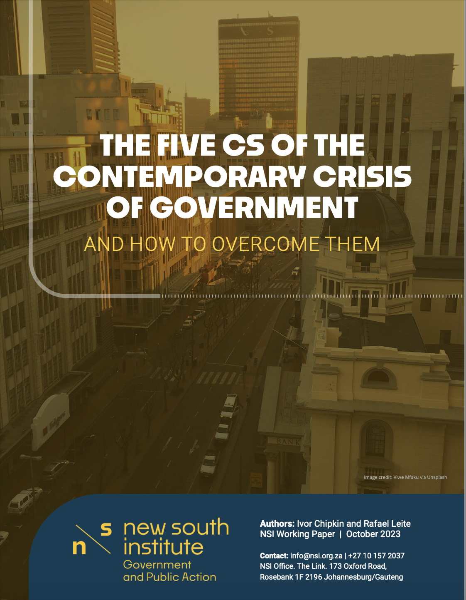
The Five Cs of the Current Crisis
A contradiction between political control and management autonomy;
Confusion regarding the respective roles of the Office of the Public Service Commission, the Department of Public Service and Administration, the Department of Planning, Monitoring and Evaluation and the Presidency, collectively the ‘centre of government’;
Weak capability in departments;
A model of centralising political power and decentralising government based on the centrality of the ANC as ruling party, and;
5. Corruption/ Criminalisation

Slide 4
Five Cs of Crisis
Contradiction (political/administrative)
Confused Accountability
Weak Capability
Corruption/ Capture
Centralised (through ANC)

Slide 5
There are solutions to these problems, some already on the agenda:
The Public Service Amendment Act – will reduce the discretion that politicians currently enjoy in appointing public servants and in interfering in operational matters. (It will help depoliticize the public service).
‘Professionalization framework’ - will introduce a basic entry test into the public administration. (It will reduce the scope for unmitigated political appointments and improve meritocratic appointments in government, especially in technical and professional roles)
Public Service Commission Reform – prior to1999 functioned as a powerful, HR vetting organisation. – powers removed in 1997 (1999). The DA’s Public Administration General Laws Amendment Bill, rejected by portfolio committee.

Slide 6
A Triple AAA Public Administration
Autonomous
Able
Accountable

Slide 7
Without these reforms, progress in solving the energy and logistics crisis will be short-lived.
Even if there is immediate progress in restoring energy supply and fixing logistics, Eskom and Transnet remain vulnerable to party political appointments in their boards and their executives and political interference in operational decisions.
Institutional stability, integrity, autonomy underlines most of South Africa’s challenges in government.
The public administration agenda must be at the top of the political agenda – we all know this, but it lacks glamour.

Slide 8
A powerful, independent movement to make the case for fixing government a ‘no brainer’
The current situation is ripe for change:
There are concrete proposals before parliament,
There are forces in the ANC strong enough to ensure that reforms are not blocked
Opposition parties are potentially in favour of government reform
To get these changes over the line in the coming months, we need:
a powerful movement of civil society organisations and business to build general support for reform and to build cross political party support for the passing of the Public Service Amendment Bill and the introduction of the Professionalisation Framework.
  Procurement Reform

Slide 9
A Second Republic
We are on the cusp of a Second Republic – deepening democracy – move from democracy as political system to democracy as government.
There are concrete proposals to modernize government – largely an initiative of progressive public servants
We need a movement to build momentum for reform to get changes over the line in next 6 months
  Procurement Reform

