Slide 1


ISSUE #03
PERSAL series · New South Institute · Johannesburg, May 2026
RETIRING THE 1994 GENERATION
The Senior Management Service – the evidence in charts
Author
Ivor Chipkin
Source
NSI PERSAL datasets, 2009–2024
Notes:
Cover. Deck summarises the SMS report: ageing of the senior management cohort nationally, in health and in education; the near-absence of managers under 50; and the completed racial transformation of the SMS.

Slide 2
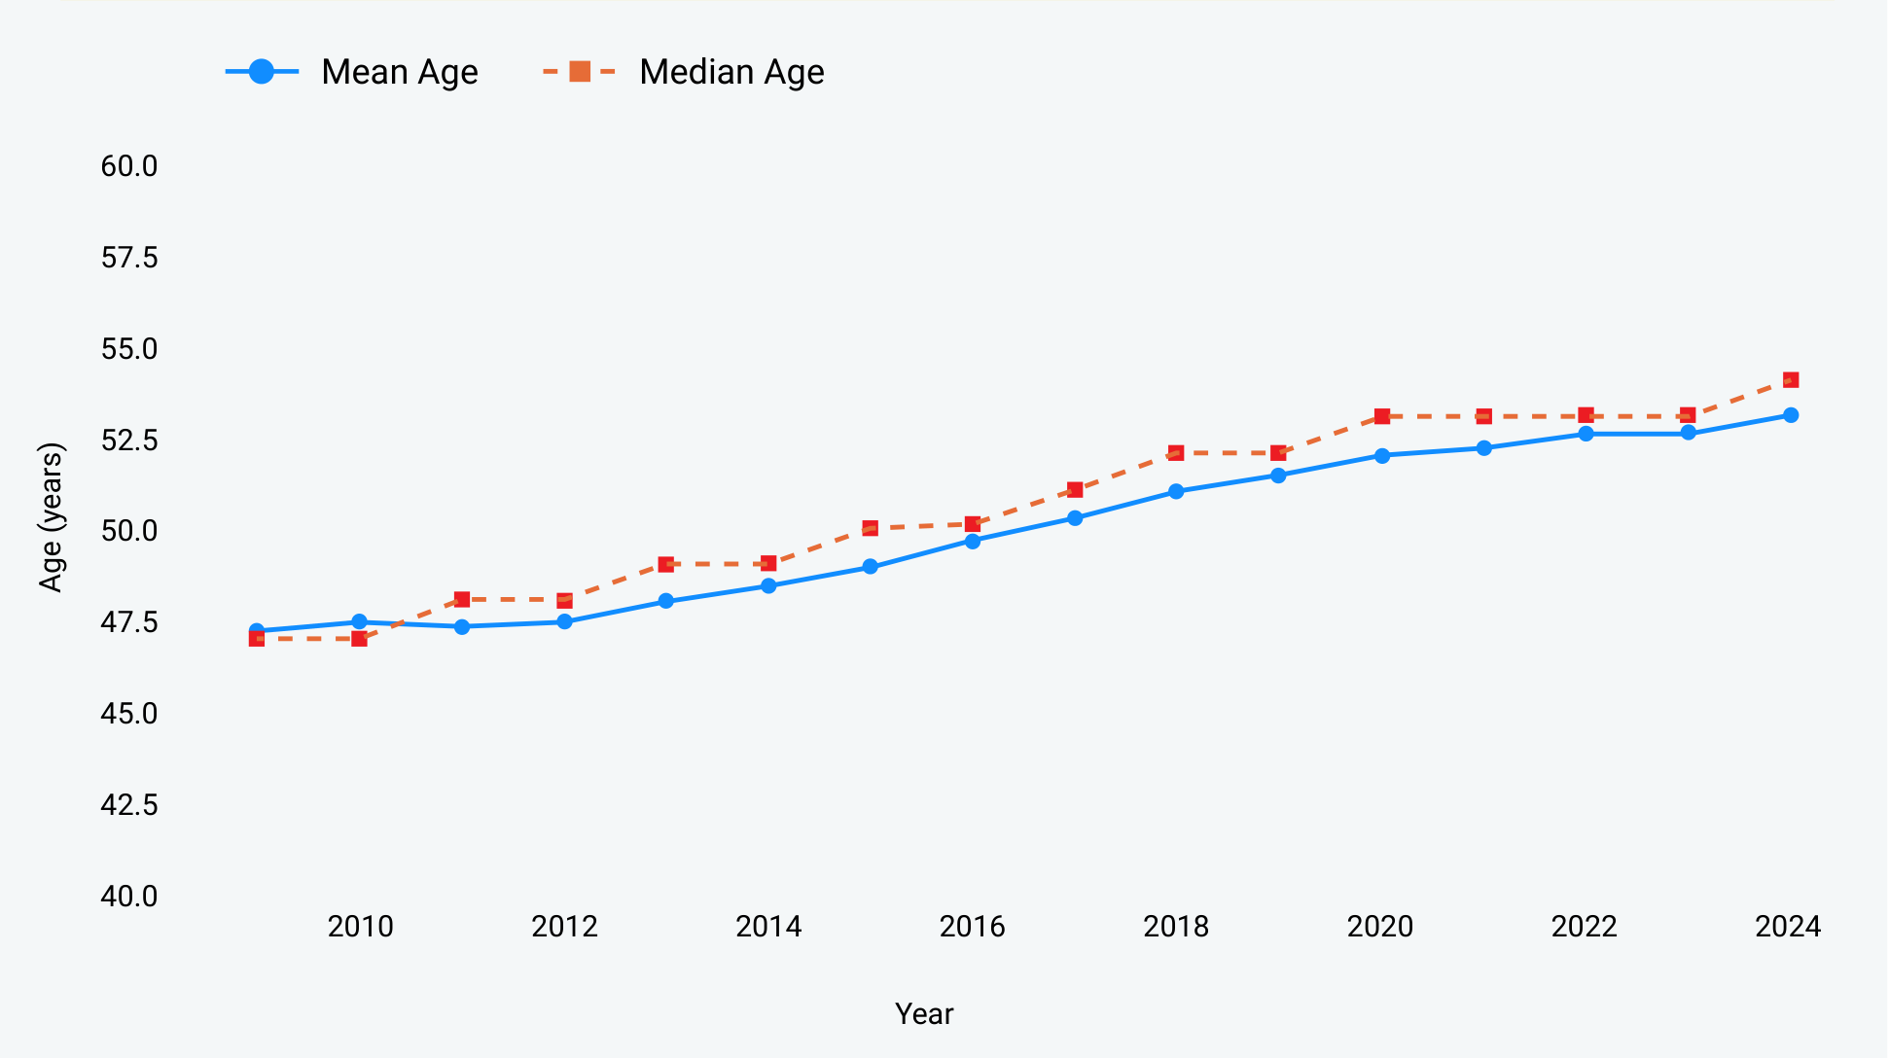
THE 1994 GENERATION IS AT THE APEX
Mean age of the SMS is 53–55 years across all three sectors – and rising by roughly one year per calendar year
Figure 2: National SMS Mean and Median Age, 2009–2024
53–55
73–80%
Mean age of senior
managers, all sectors
of SMS members are
aged 50–65 (2024)
‘The corps neither grew substantially nor renewed itself through the entry of younger members. The cohort ages together, like a vintage of wine.’
Mean age rose from 47.4 years in 2009 to 53.2 in 2024 – almost exactly one year of ageing for every calendar year that passed.
– NSI, Series 3, 2026
Using data and evidence to strengthen South Africa’s democracy
2
Notes:
Mean and median age of the national SMS rise almost exactly one year per calendar year - the mathematical signature of a closed cohort ageing in place.

Slide 3
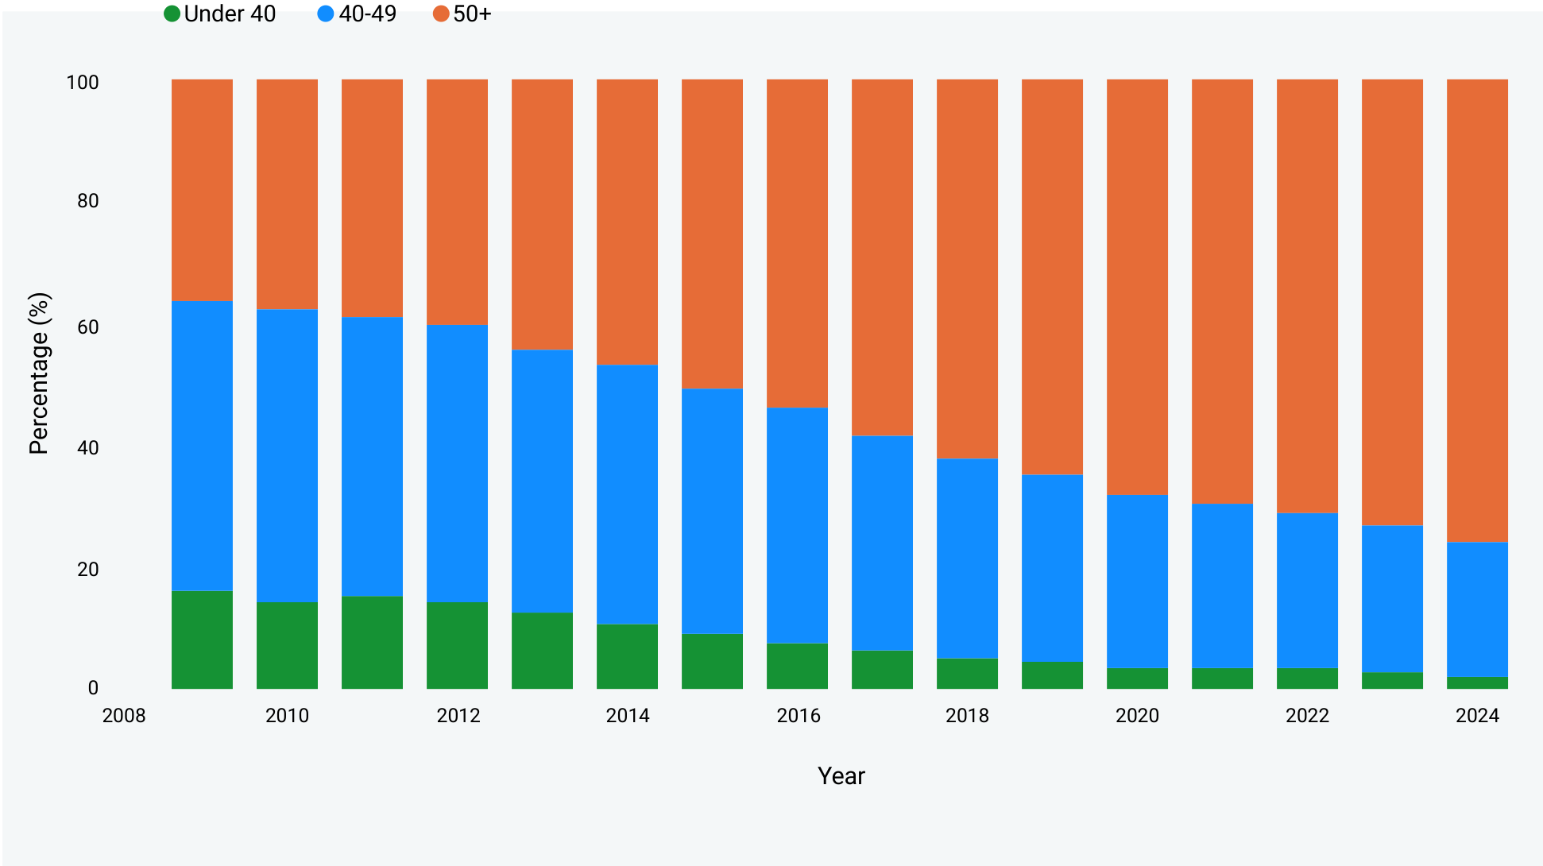
THE NATIONAL SMS: A PROFILE THAT HAS INVERTED
In 15 years, the over-50 share has more than doubled while every younger bracket has thinned
Figure 1: National SMS Age Bracket Distribution (%), 2009–2024
2009
16.2%
under 40
47.3%
aged 40–49
36.5%
over 50
2024
2.7%
under 40
21.4%
aged 40–49
75.9%
over 50
The under-40 cohort has collapsed from one-in-six to fewer than one-in-forty.
Using data and evidence to strengthen South Africa’s democracy
3
Notes:
Green = under 40, blue = 40-49, orange = 50+. The green band all but disappears and the blue band halves.

Slide 4
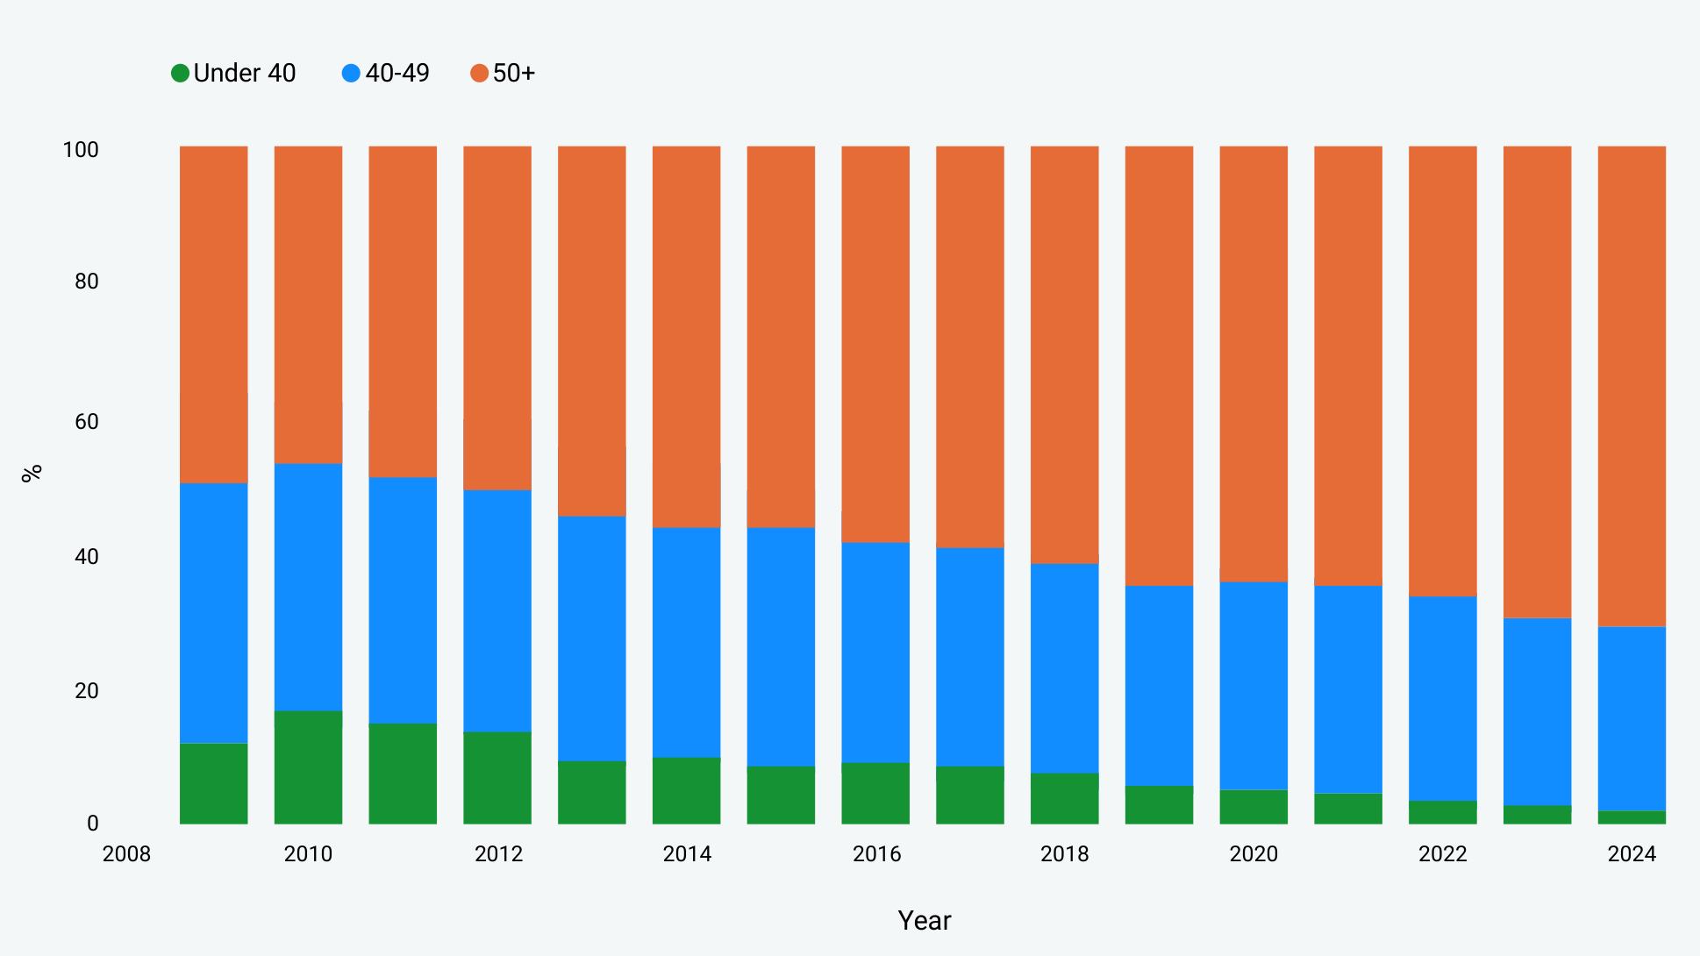
HEALTH: A DOUBLE AGEING CRISIS
Figure 5: Health SMS Age Bracket Distribution (%), 2009–2024
53.6
Mean age of health senior managers (2024)
71.4%
of the health SMS is over 50
A wave of nursing retirements will coincide with a wave of health SMS retirements – a systemic state capacity crisis in health governance.
Using data and evidence to strengthen South Africa’s democracy
4
Notes:
Nurses over 50 are roughly 37%; their managers are 71.4% over 50. Both layers age together while the management corps halves in size.

Slide 5
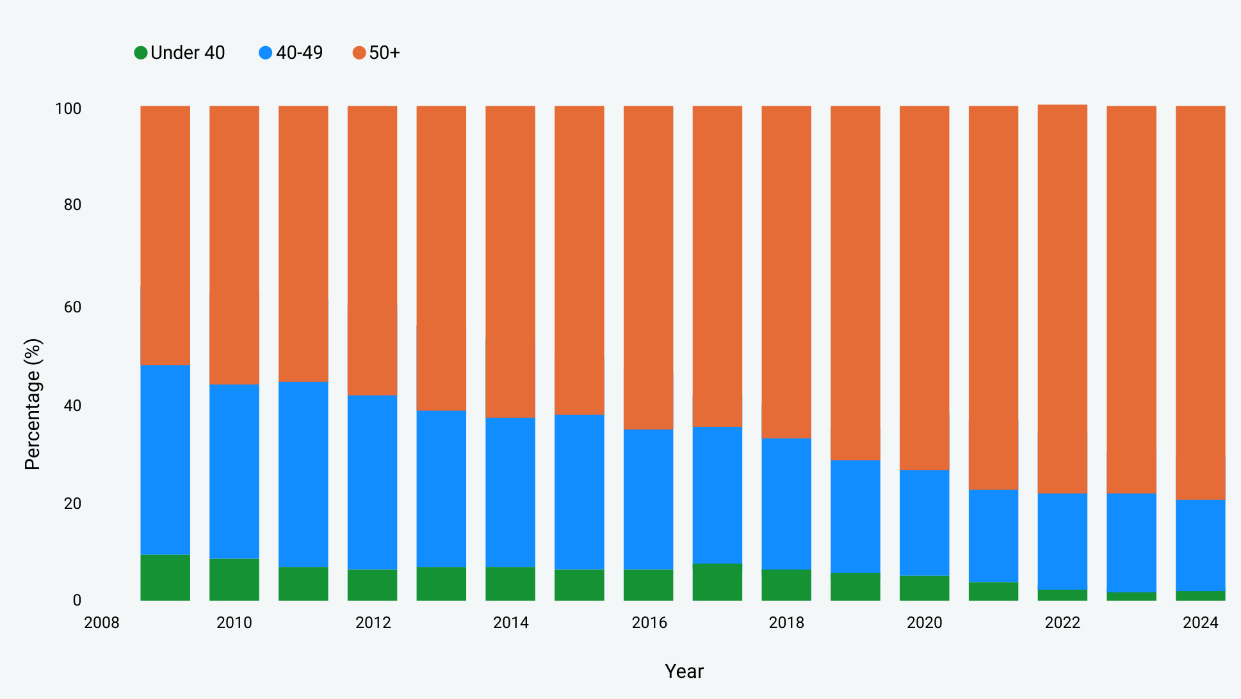
EDUCATION: THE OLDEST CADRE WE HAVE ANALYSED
A mean age of 55 means the average senior education manager reaches retirement within five years
Figure 7: Education SMS Age Bracket Distribution (%), 2009–2024
55.0
Mean age of the education SMS – the oldest cadre analysed
80.2%
of education senior managers are over 50
30–33%
of teachers are over 50 – the layer they manage
The management layer is ageing faster than the workforce it governs. On current trends the next Director-General of a provincial education department may not yet be in the SMS today.
Using data and evidence to strengthen South Africa’s democracy
5
Notes:
Education is the most acute case: 80.2% of senior managers over 50, against 30-33% of teachers.

Slide 6
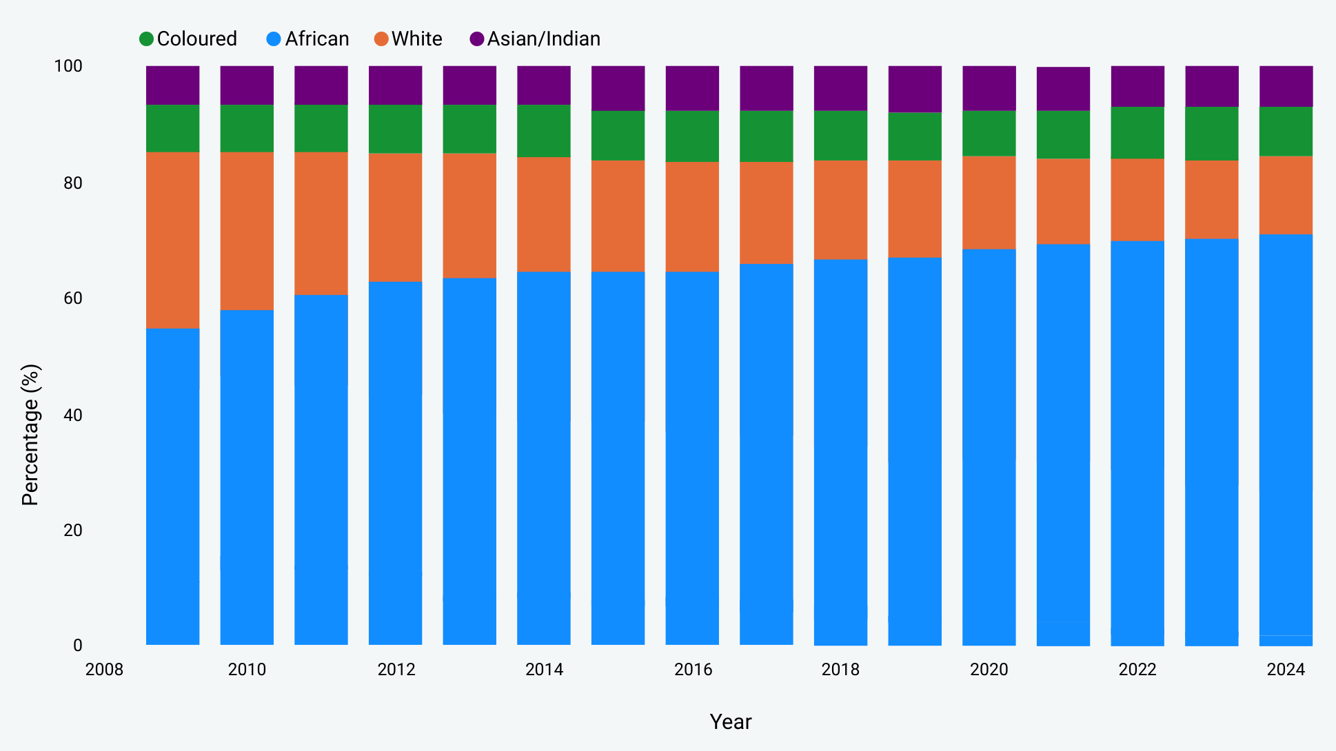
RACIAL TRANSFORMATION: COMPLETE AT THE APEX
Achieved within a single generation – African representation in the national SMS has risen from 54.5% to 71.2%
Figure 8: National SMS Race Composition, 2009–2024
African representation, national SMS
54.5% → 71.2%
White representation, national SMS
31.1% → 13.3%
Thirty years ago national senior management was overwhelmingly White.
The African managers who replaced White incumbents after 1994 are themselves now approaching retirement.
Female representation has risen from 30.5% to 42.9% – parity is still unmet.
Using data and evidence to strengthen South Africa’s democracy
7
Notes:
Blue = African, orange = White, green = Coloured, purple = Asian/Indian.

Slide 7
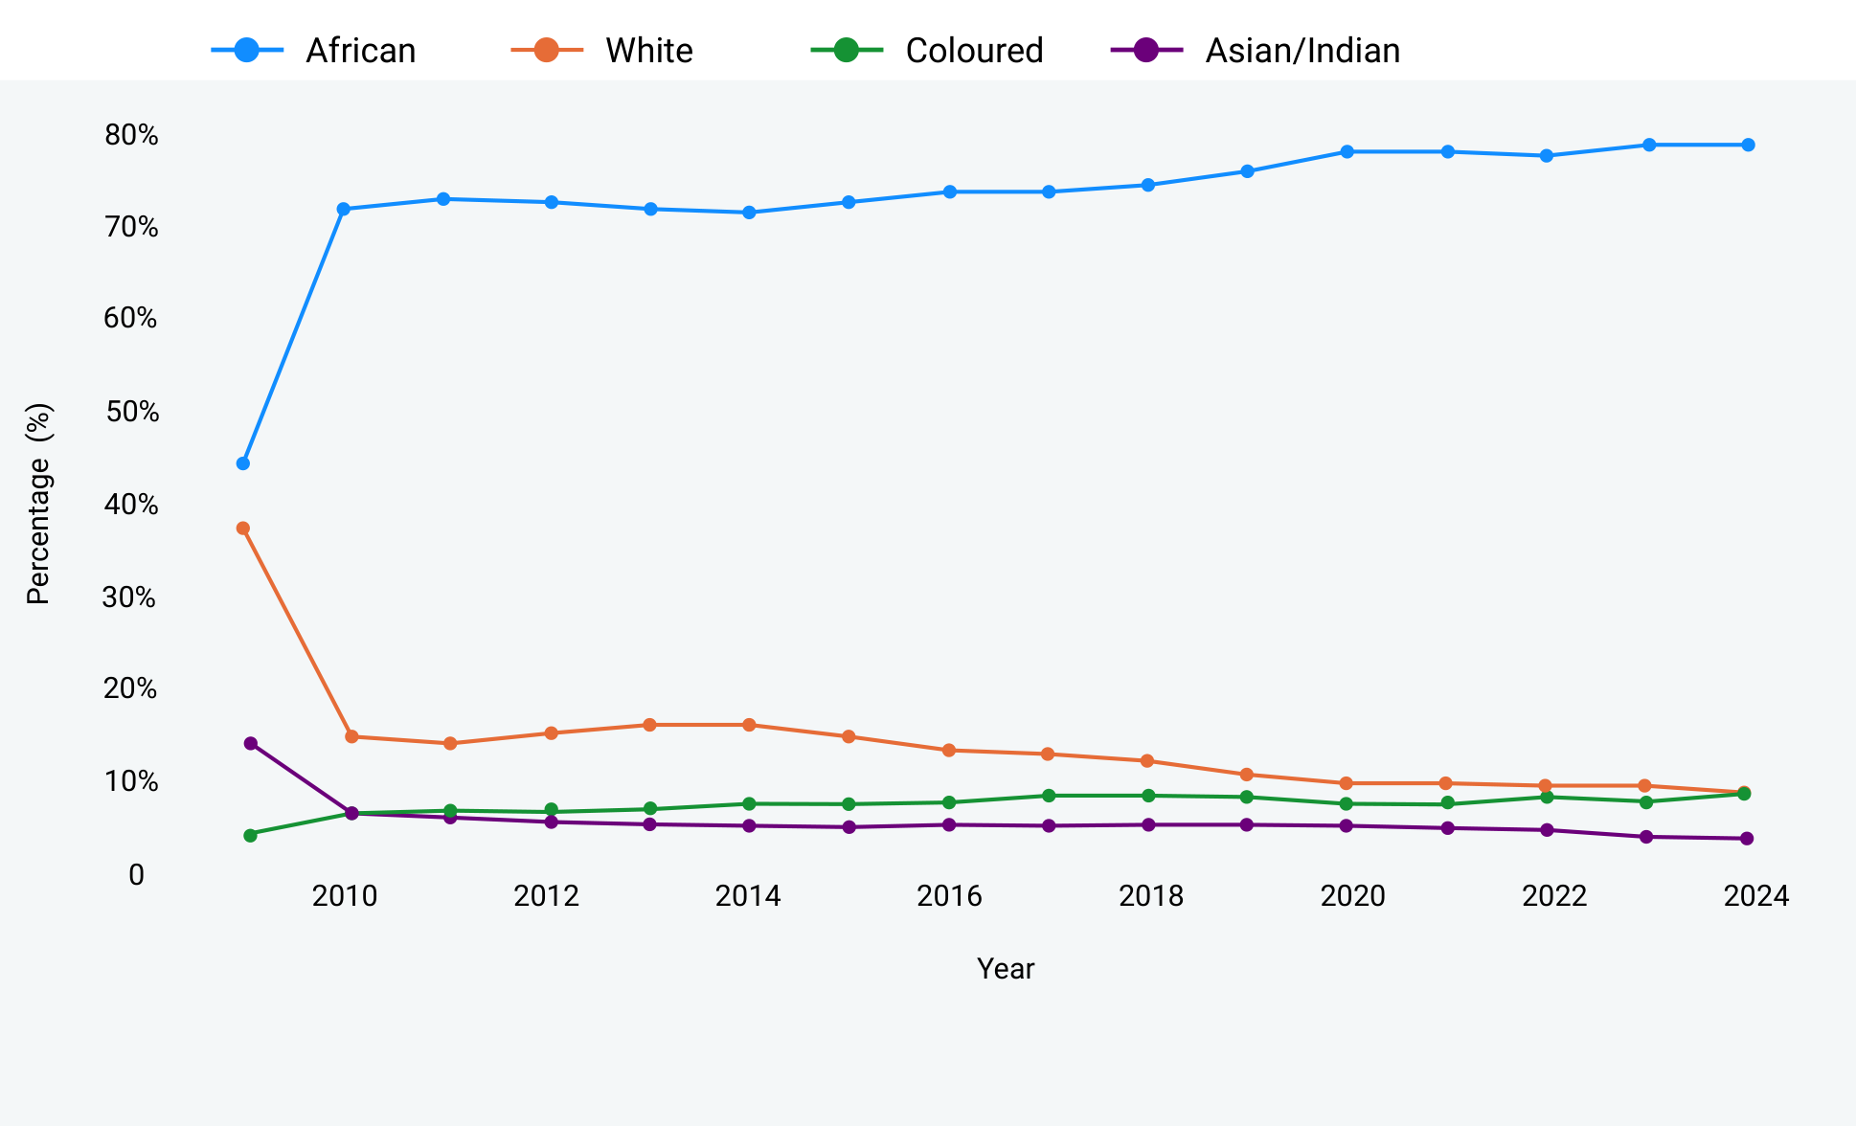
HEALTH: THE FASTEST AND MOST COMPLETE TRANSFORMATION
African representation in the health SMS rose from 44.2% in 2009 to 78.8% in 2024
Figure 6: Health SMS Race Composition Over Time, 2009–2024
44.2% → 78.8%
African share of the health SMS, 2009 → 2024
66.4% → 77.7%
African share of the education SMS, 2009 → 2024
This extraordinary transformation has occurred in a shrinking and ageing corps. It is a transformation of the character of the 1994 generation of managers – not a transformation that has produced a new generation.
Using data and evidence to strengthen South Africa’s democracy
8
Notes:
Health transformed later but further than any other sector analysed.

Slide 8
TRANSFORMATION ACHIEVED.
SUCCESSION NOT YET BEGUN.
The people who built post-apartheid government are in their fifties. Most will retire within the next decade, and the retirement of the 1994 SMS cohort will create the largest wave of senior government vacancies since 1994 itself.
The window is open, but not for long.
Retiring the 1994 Generation: The Senior Management Service · NSI PERSAL series, Issue #03 · info@nsi.org.za
Notes:
Closing. Source: NSI PERSAL datasets 2009-2024; all figures reproduced from the report.

